Slide 1

ANKIT CHAND
DDS2020080

Slide 2
Problem Statement
Goal of this project is to implement machine learning model to predict the power that is generated (in KW/h) based on the various features provided in the dataset

Slide 3
Dataset Size
Train Dataset: [28200 x 22]
Test.csv: [12086 x 21excluding the headers]
Target column is to predict the power that is generated (in KW/h)

Slide 4
Approach
Understanding data with visualization.
Pre-Process data
Feature Selection
Evaluate Algorithm
Algorithm Evaluation metrices
Model Selection based on the candidate models.

Slide 5
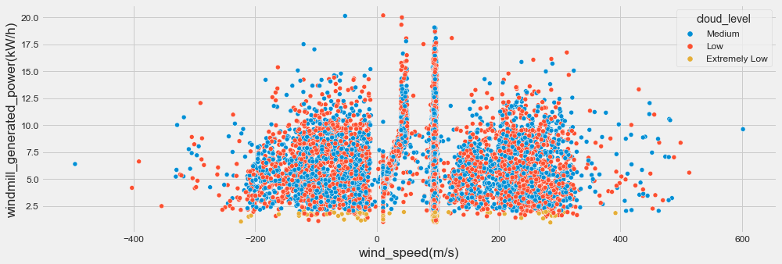
Some Inference
most of the cloud_level range between -200 to 300 (m/s), and helps windmill to generate power ranging approx. 13kW/h

Slide 6
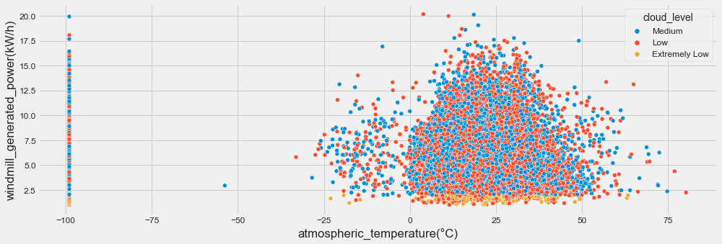
most of the cloud_level range between 0 to 50(°C), and helps windmill to generate power ranging approx. 16kW/h
clearly there were outlier in -100°C, where concentration cloud_level is seen.

Slide 7
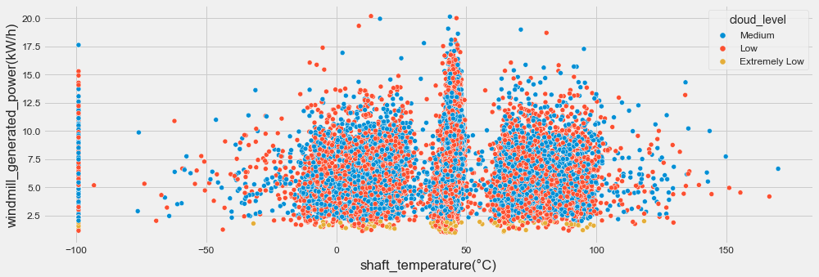
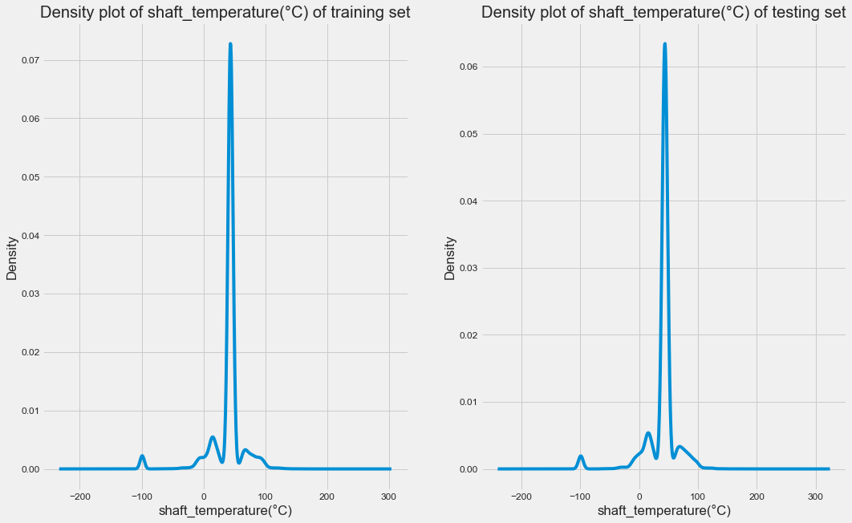
most of the cloud_level range between -10 to 100(°C), and helps windmill to generate power ranging approx. 16kW/h
From the above density plot of feature "shaft_temperature(°C)", we found that the distribution of "shaft_temperature(°C)" is almost same in training and testing dataset, so we are not changing anything in it.

Slide 8
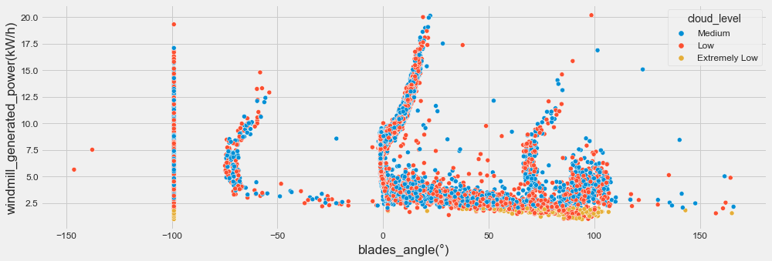
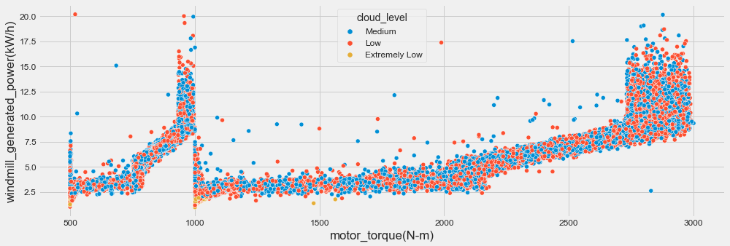
From the above distribution of "blades_angle(°)" and "motor_torque(N-m)" is almost same in training and testing dataset, so we are not changing anything in it.

Slide 9
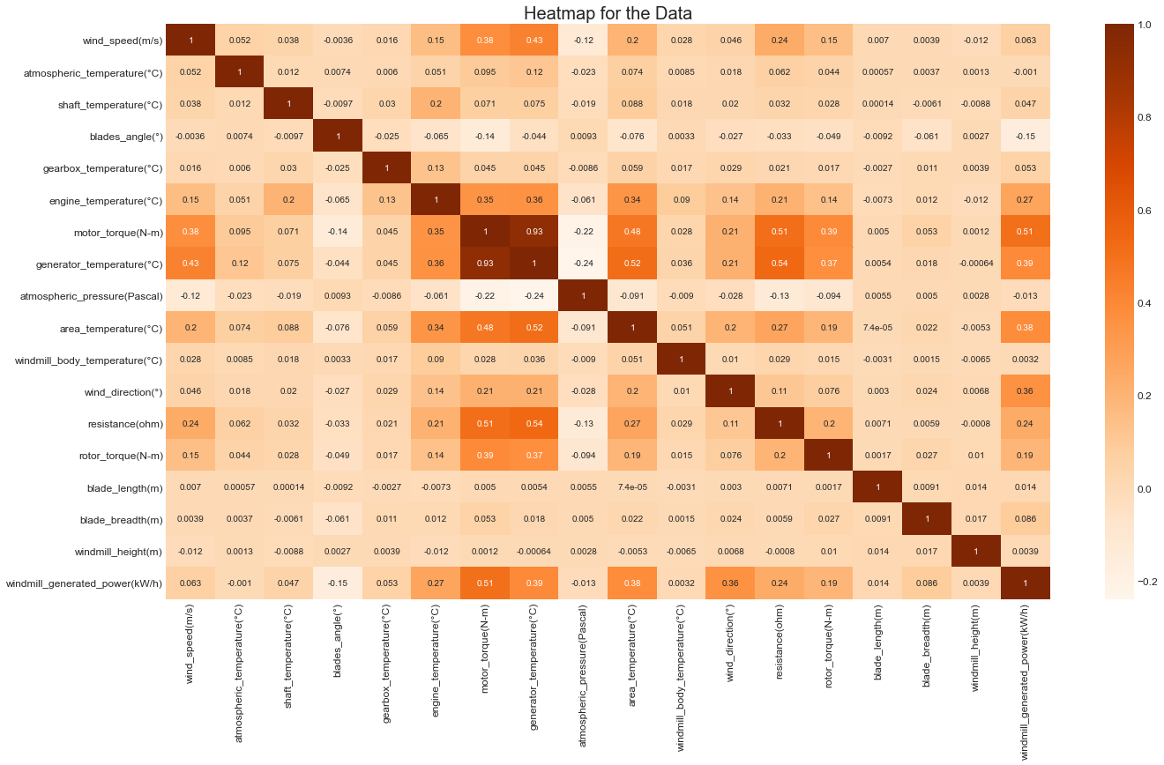
From the above plot, features “motor_torque(N-m)” and “generator_temperature(°C)” are highly correlated and therefore we will be dropping one of them in the end.

Slide 10
Data Preprocessing
Used boxcox for positively skewed datasets and logarithm for negatively skewed dataset.
Created dummies for categorical data.

Slide 11
Candidate Models used here
Used Light boost(LGBM) and got accuracy as 96.457% on test file.
Used Extreme gradient boost(Boost) and got accuracy as 96.33% on test file.
Used Gradient boost(Boost) and got accuracy as 96.31% on test file.
Used Random Forest and got accuracy as 96.21% on test file.
Secured rank 34 while submitting, currently my rank is 36

Slide 12
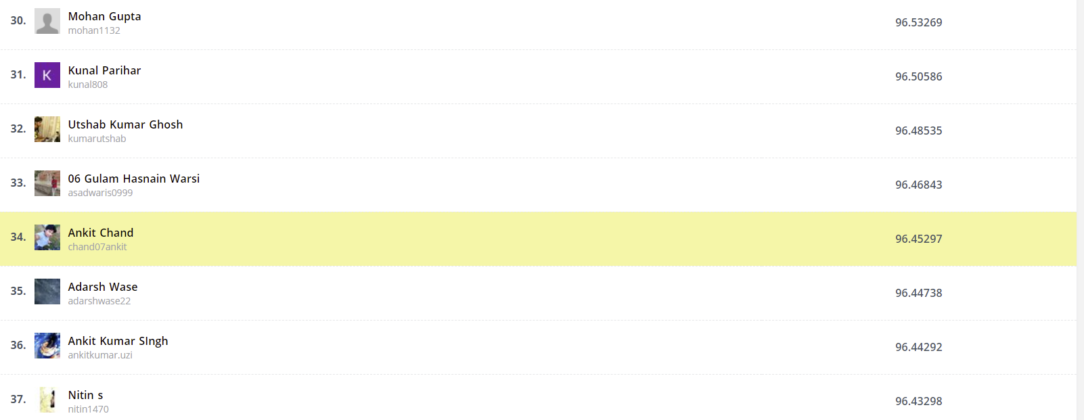
Thank You

